Slide 1
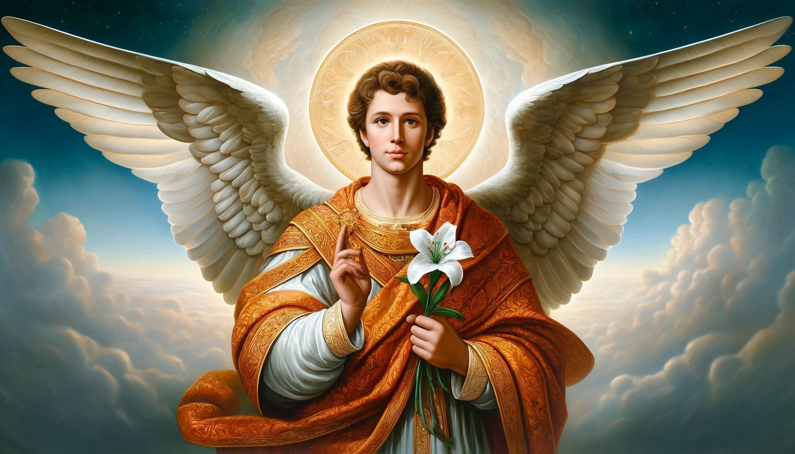
St. Gabriel, the Archangel
​

Slide 2
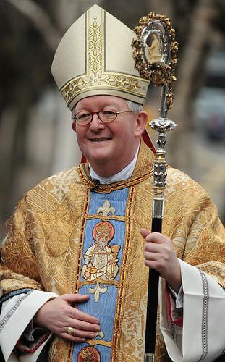
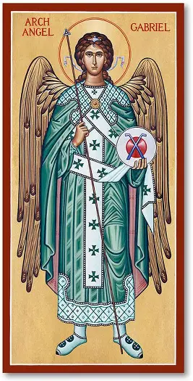
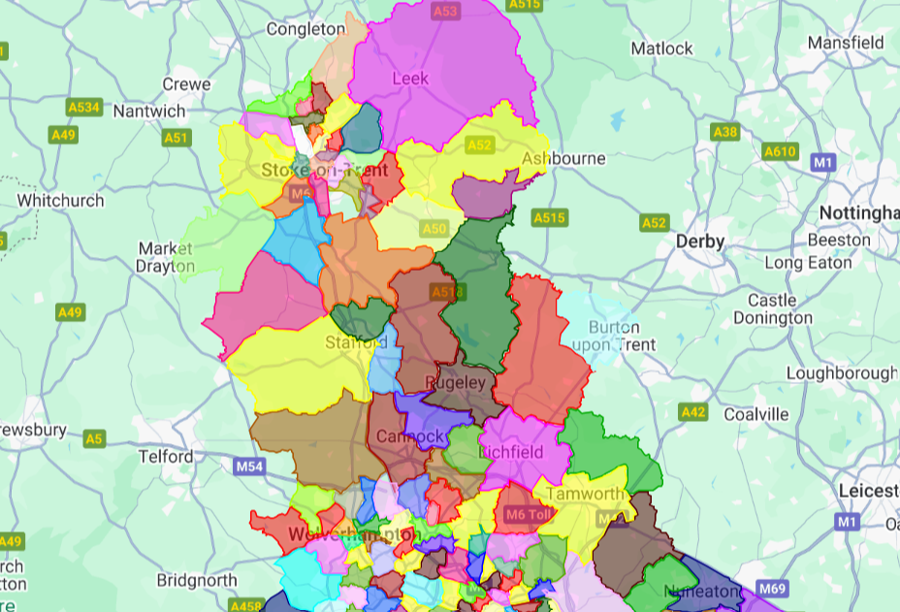

63 schools!
Over 21,500 pupils!
Covering - Stoke on Trent, North Staffordshire, Wolverhampton, and the Black Country.

Slide 3
St. Gabriel is an angel, the messenger of God.
He is one of the three archangels.
Gabriel is mentioned in both the Old and the New Testaments of the Bible.
Unlike most saints, Gabriel was never a human being who lived on Earth but instead has always been a heavenly angel who was declared a saint in honor of work helping people on Earth.

Slide 4
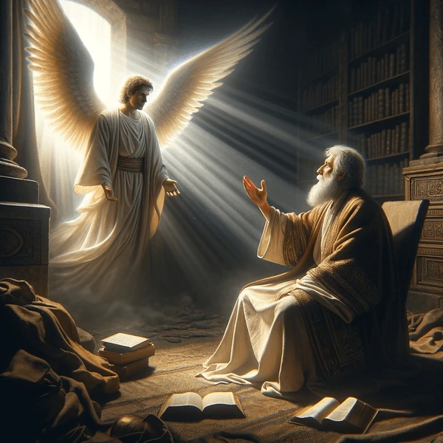
In the Old Testament, Gabriel appears to the prophet Daniel twice.
First to explain his visions that are troubling him.
Second when he is praying to God for his people and Gabriel appears to reassure him from God.

Slide 5
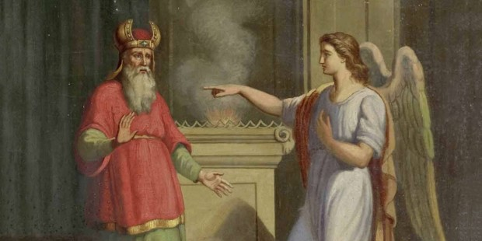
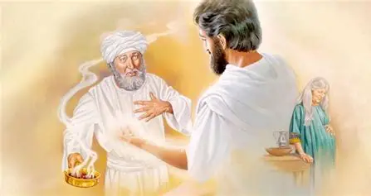
In the New Testament, Gabriel appears to the Zechariah to tell him that his wife Elizabeth will have a son even though they were old (John the Baptist).
But because Zechariah doubted him, he couldn’t speak until after John was born when he used his voice to praise God!

Slide 6
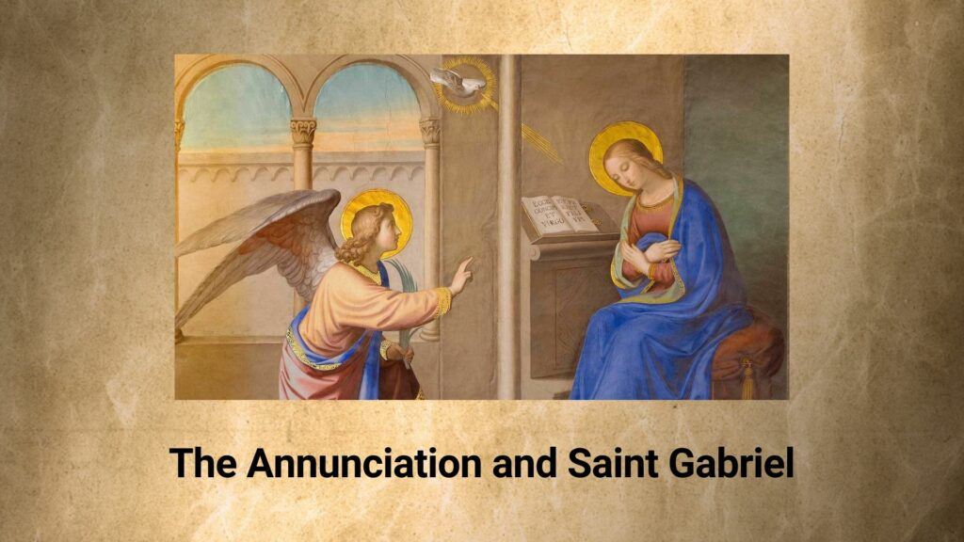
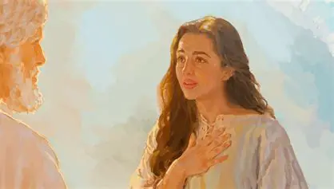
In the New Testament, Gabriel then appears to Mary to tell her she will have a baby who will be God’s son named Jesus.
Mary responded to Gabriel’s message with complete faith.

Slide 7
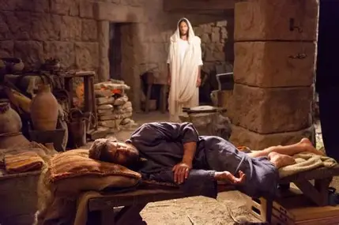
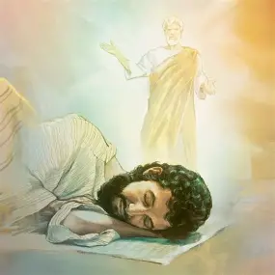
In the New Testament, Gabriel appears to Joseph to reassure him because he is troubled when he hears the news that Mary is pregnant.
Joseph is obedient to Gabriel’s message from God and does as he asks.

Slide 8
Gabriel is an important angel mentioned in the Bible. His name means "God is my strength" or "man of God."
He is known as an archangel, which means he is a chief or highest-ranking angel.

Slide 9
Gabriel is recognised as the patron saint of messengers, telecommunication workers, and postal workers.
His feast day is celebrated on 29th September.
The Angel Gabriel delivers important messages and helps people do the same.

Slide 10
St Gabriel, the messenger of God, is a symbol of hope, guidance, and divine communication.
St Gabriel brought the most important and joyous news of Christ’s coming to Mary.
Let us listen to those messages and be like St. Gabriel sharing the Good News to everyone we meet in both our words and actions.

Slide 11
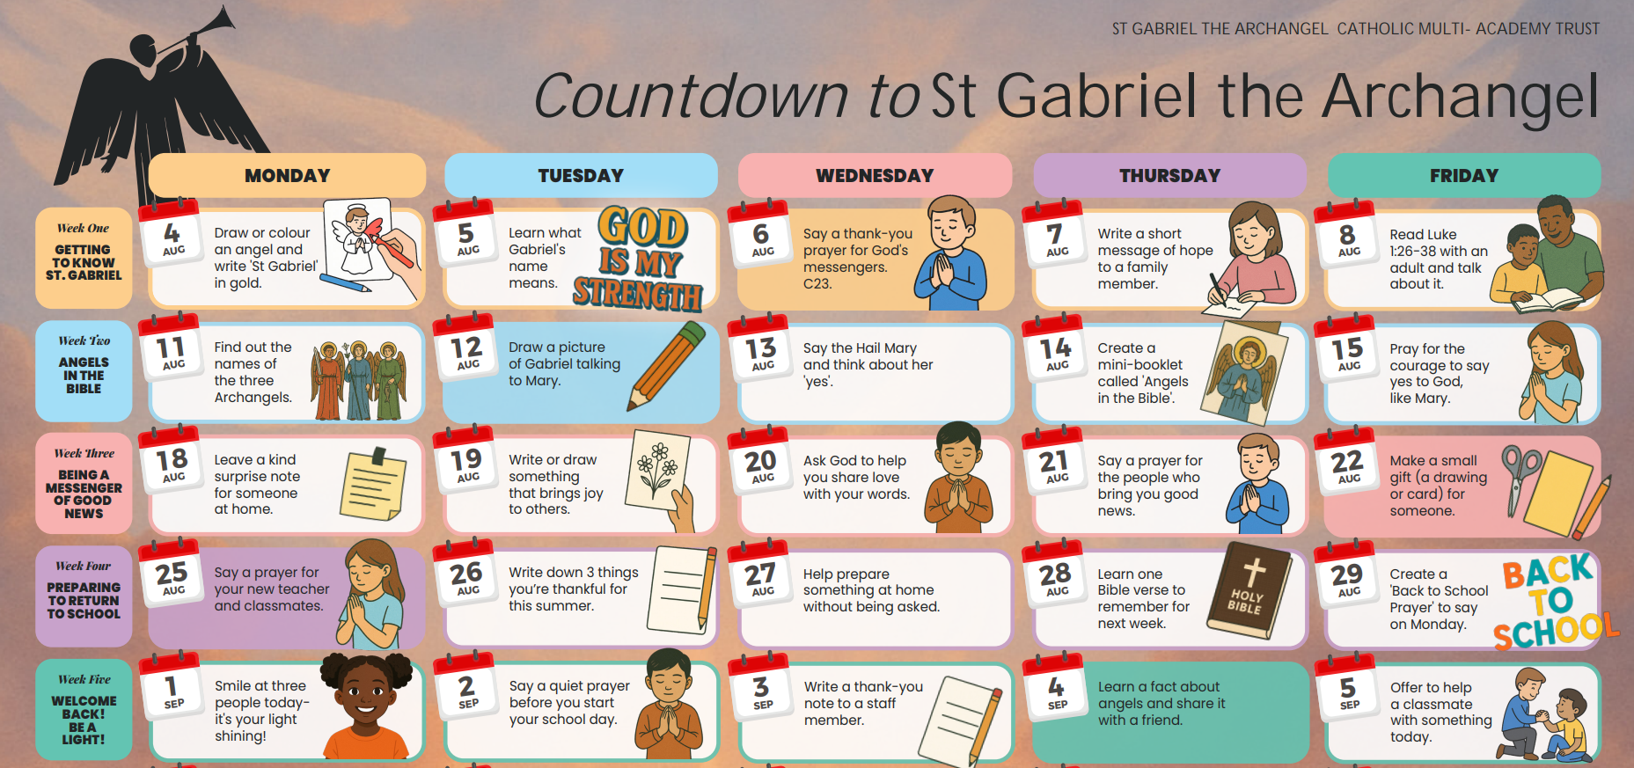
On the 29th September the whole of our new CMAT will all celebrate the feast day of St. Gabriel the Archangel.

Slide 12
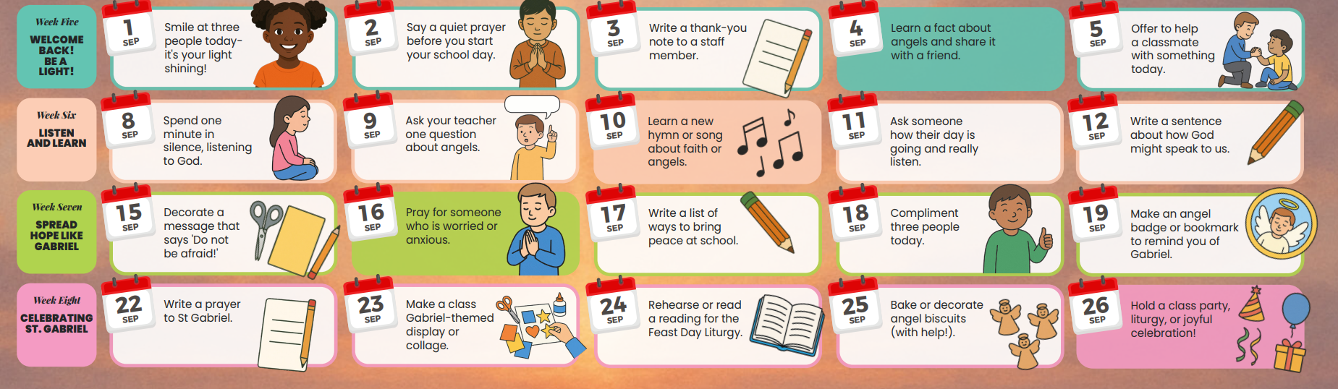
This week – Be a light!
Let’s look at the actions for this week ……

Slide 13
St Gabriel,
Guide me in the choices I make today and be there to light up my path.
Bring me peace and understanding and strengthen my ever growing faith in God.
Protect me and keep me from
harm.
Fill my life with God’s love.
Amen

